Slide 2

Hello! I’m Penny Penguin.
I live in Antarctica.
I would like to tell you about some famous people who have explored where I live!

Slide 3
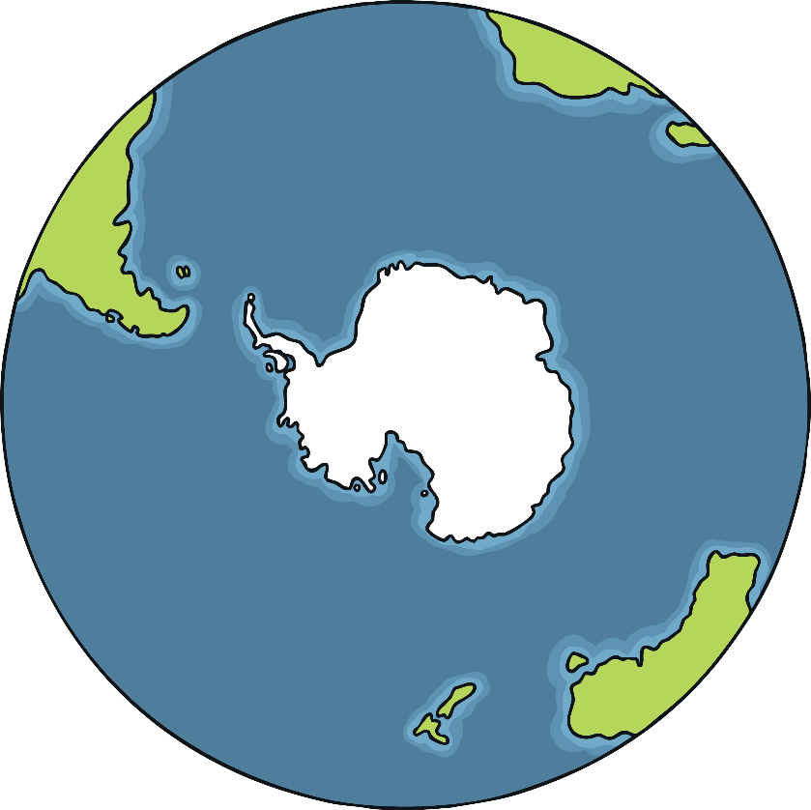

Where Is Antarctica?
Antarctica is one of the seven continents
of the world.
The South Pole is in Antarctica.
Can you tell me anything you know about the South Pole?

Slide 4
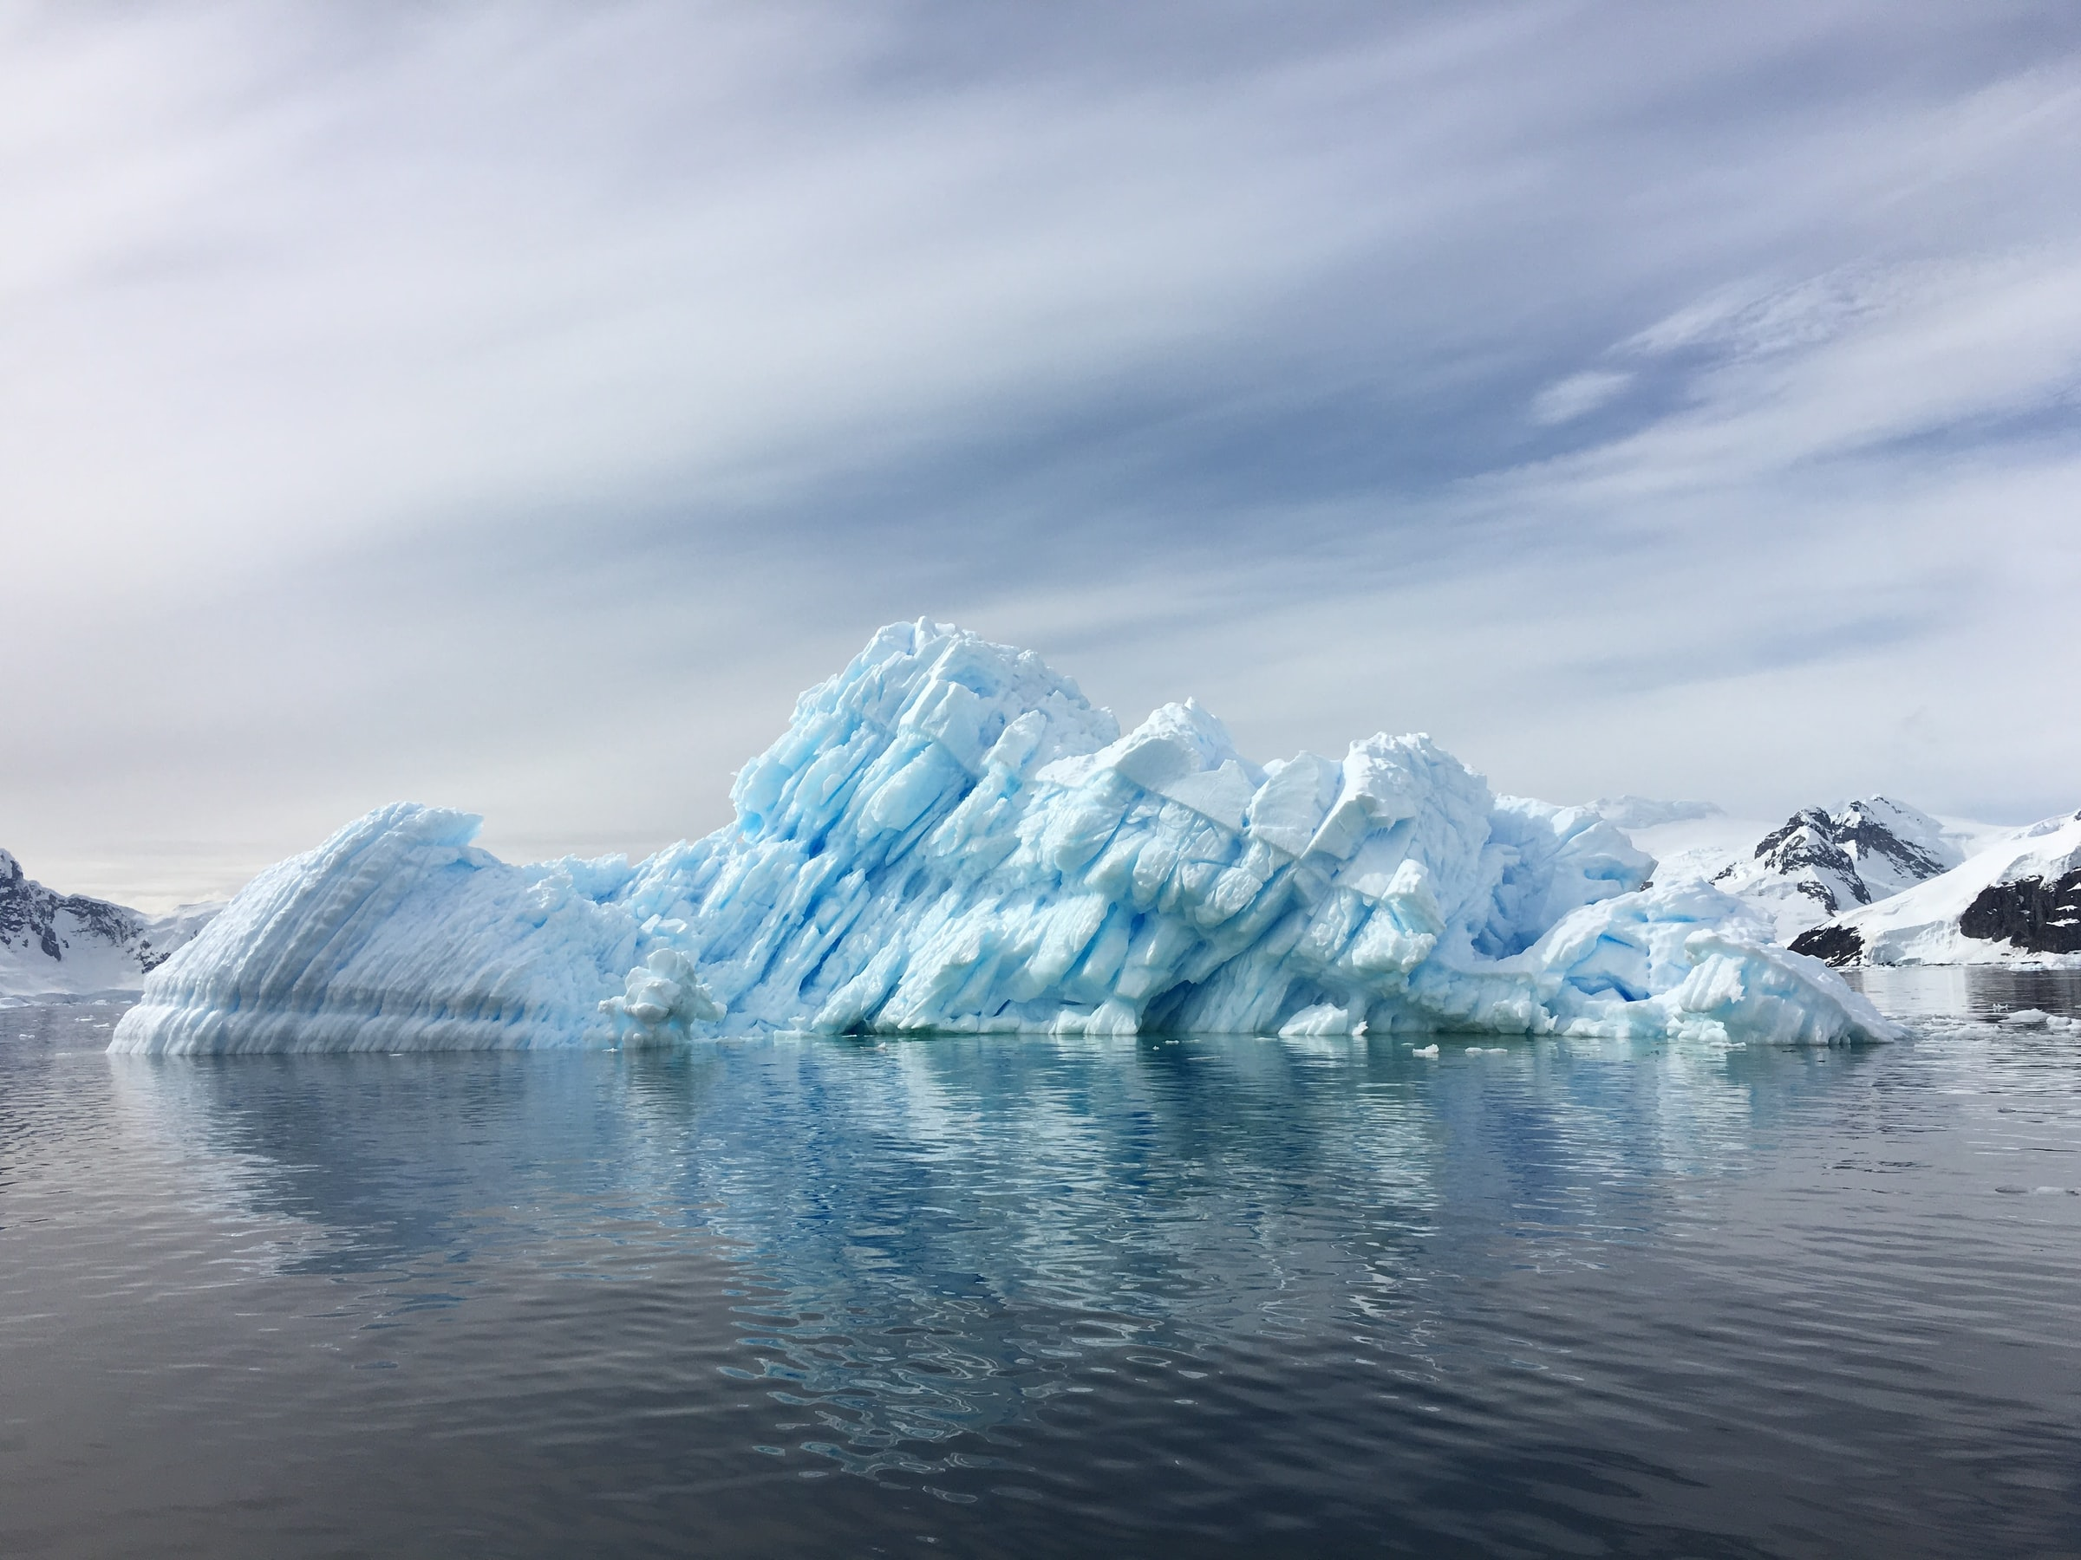
Antarctica is the coldest and windiest continent. It is covered in snow and ice. It is so cold that plants and animals find it very difficult to live there.
Look at the picture. What do you think the weather is like in Antarctica?

Slide 5

Finding the South Pole
For a very long time, Antarctica had never been found by humans.
Once they found Antarctica, lots of people wanted to reach the South Pole.
It is not an easy journey!
South Pole
Why do you think it’s difficult to get to the South Pole?

Slide 6
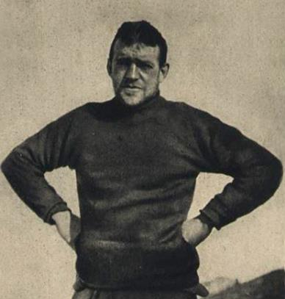
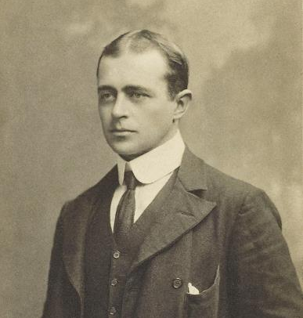
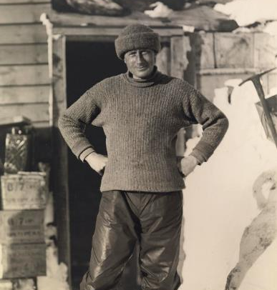
The First Attempt
In 1902, three men set off on an expedition called ‘The Discovery Expedition’ to try and find the South Pole. Their names were Robert Scott, Edward Wilson and Ernest Shackleton.
What do you notice about the pictures?

Slide 7
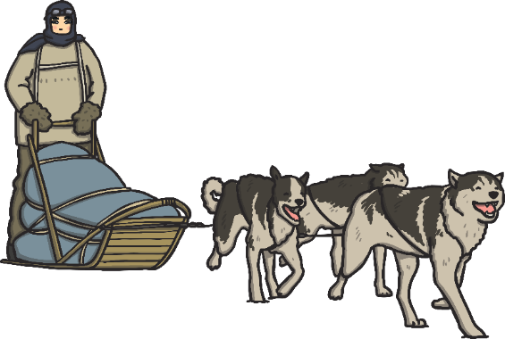
The Discovery Expedition
Scott, Wilson and Shackleton travelled across the snow and ice by sleds that were pulled by dogs.
They managed to travel the furthest across Antarctica then anyone had ever managed before.
Unfortunately, the conditions were very difficult and they had to turn back.
How do you think they felt when they had
to go home before getting to the South Pole?

Slide 8
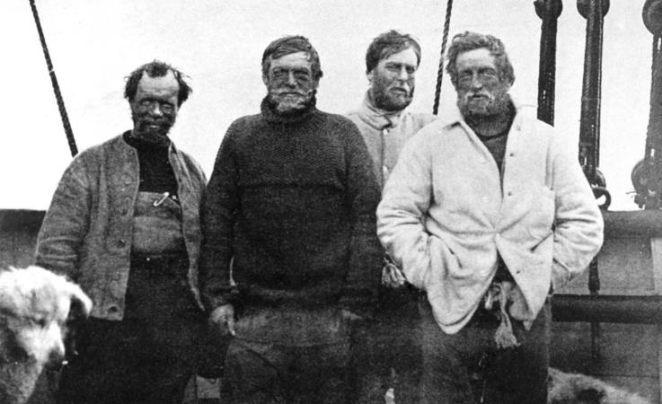
The Second Attempt
In 1908, Ernest Shackleton decided to make another attempt to reach the South Pole. This time, he travelled with Frank Wild, Eric Marshall and Jameson Adams.
They called this the ‘Nimrod Expedition’.

Slide 9
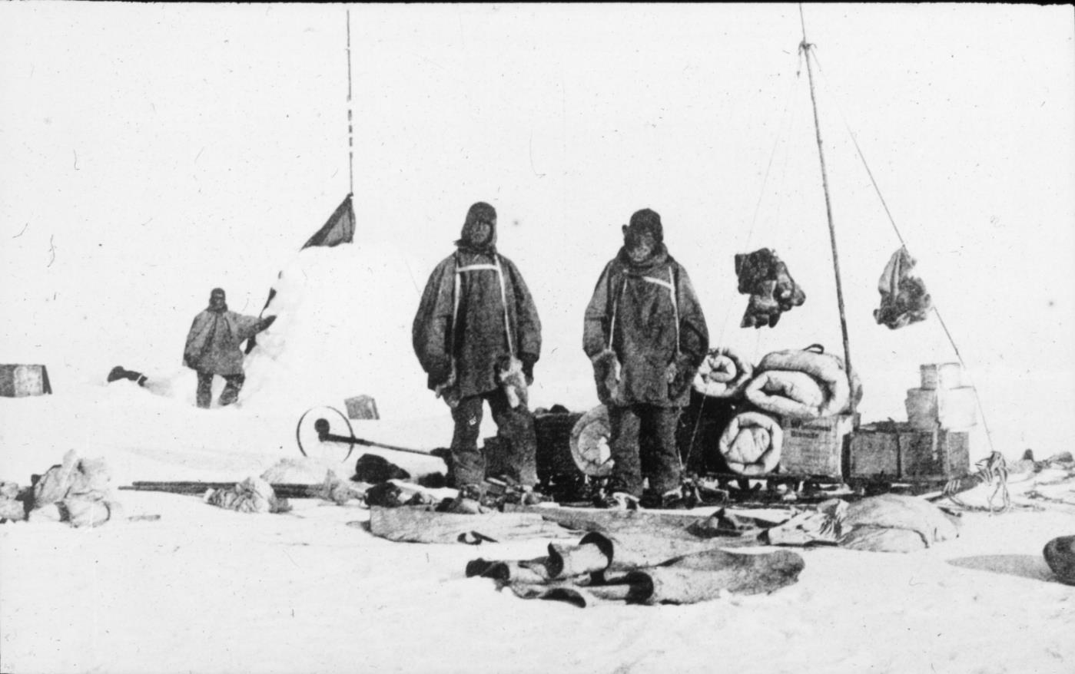
The Nimrod Expedition
Travelling across Antarctica was very hard. The temperature was very cold and they had to pull all of their equipment on their sleds.
What equipment do you think they had to carry with them? Click me to find out.

Slide 10
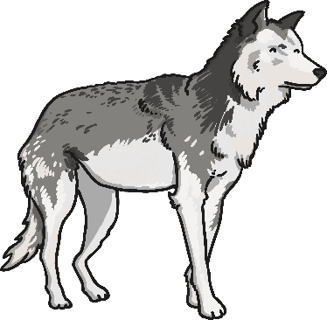

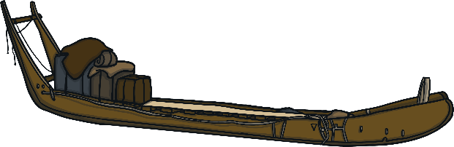

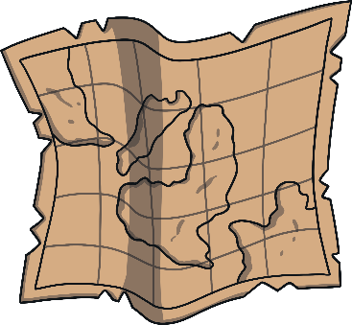
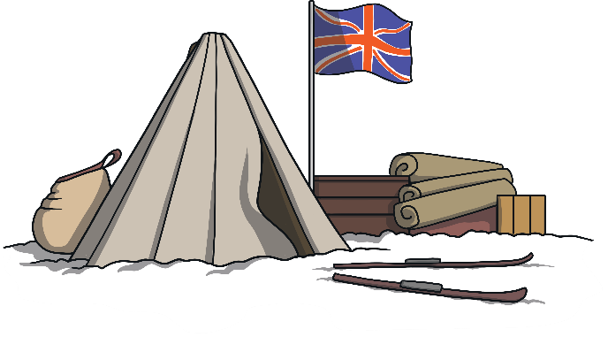

Equipment
The men needed strong dogs to help pull their sleds full of equipment.
They had tools with them, such as pickaxes and ropes. They needed them to help clear paths through the thick snow and ice.
They needed maps to help guide them to the South Pole.
They carried their food with them. They needed to take tins of food so it could last a long time. They needed food that would give them energy as it was very hard work.
They carried resources for building a camp when the men needed to rest.

Slide 11
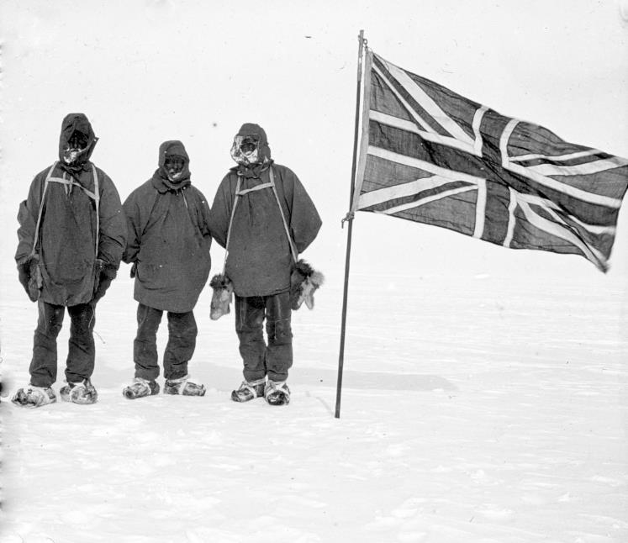
The Nimrod Expedition
The men made it further than Robert Scott’s Discovery Expedition in 1902. But unfortunately, they didn’t reach the South Pole. The men began to run out of food and became ill so they had to return home.
How do you think they felt when they had to end the mission without reaching the South Pole?

Slide 12
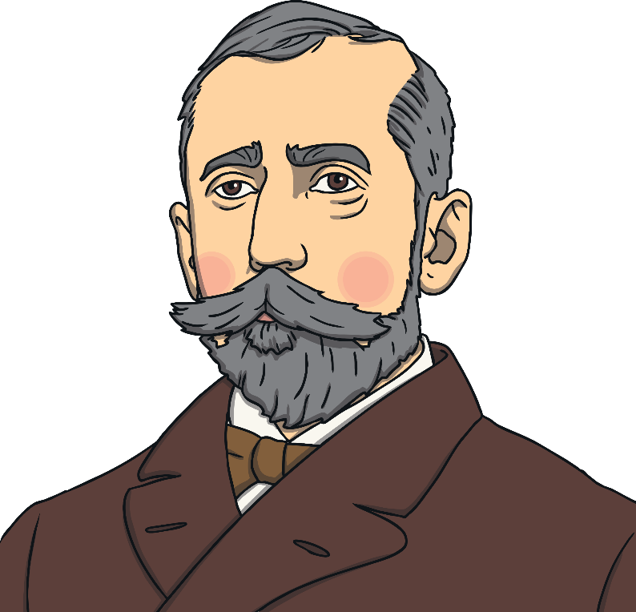
The Third Attempt
In 1910, Robert Scott decided to set off on another expedition to the South Pole. This was named the ‘Terra Nova Expedition’. They spent some time planning what the route they would take and gathering together the equipment they needed.
In 1911, twelve men set off for Antarctica with the goal of being the first people to reach the South Pole. This time, it was going to be a race as another explorer, Roald Amundsen from Norway, was also in Antarctica, trying to be the first person to reach the South Pole.
How do you think the Terra Nova team felt when they
found out there was already someone else in Antarctica, trying to get to the South Pole?

Slide 13
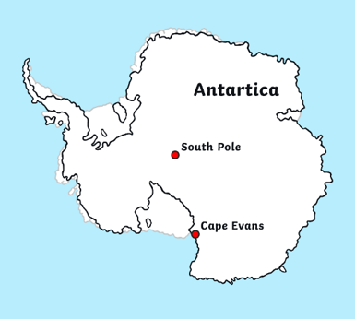
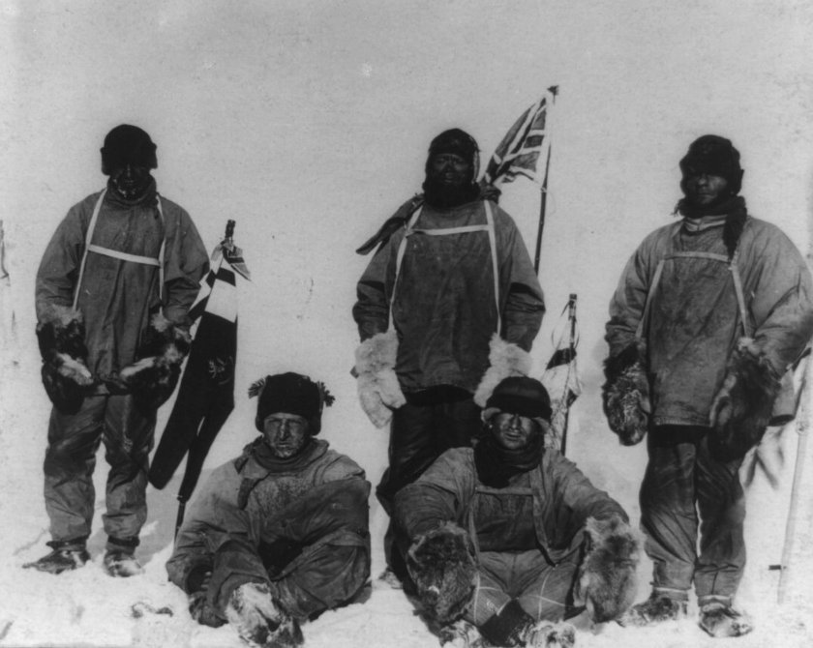
The Terra Nova Expedition
They built a base at an area they named ‘Cape Evans’. The twelve men set off for the South Pole. Part of the way through the expedition, seven men headed back to the base, leaving Scott, Oates, Bowers, Wilson and Evans to head to the South Pole.

Slide 14
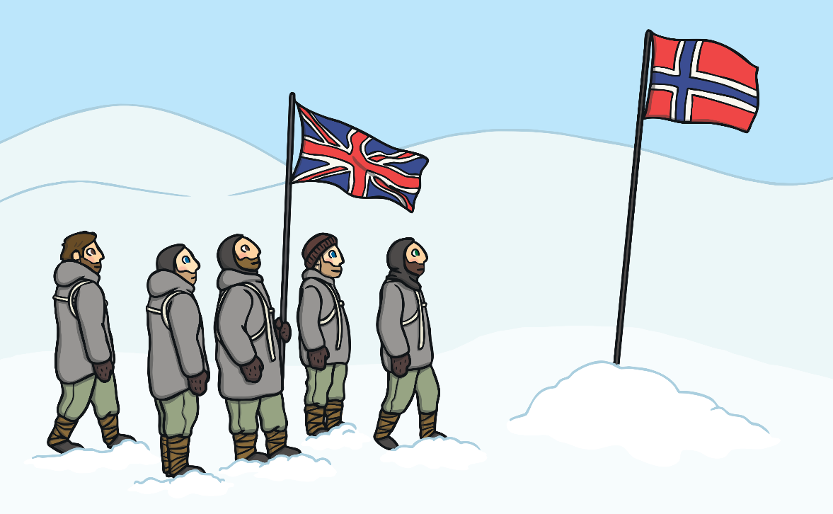
The Terra Nova Expedition
They reached the South Pole on the 17th January 1912.
Unfortunately, when they arrived, they realised that Roald Amundsen and his team had got there first!
They planted their flag in the snow and headed back to their base camp.
How do you think they felt when they saw that Amundsen had got to the South Pole first?

Slide 15
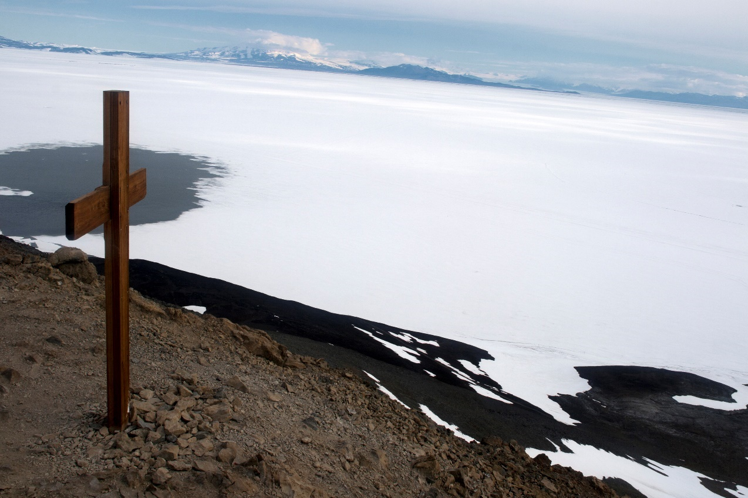
The Terra Nova Expedition
Sadly, the journey back to their base camp was very cold and difficult. The men got poorly with frostbite and unfortunately never made it back.
In 1912, a team set out to find the five men.
They planted a cross as a memorial to remember their bravery and
dedication to reaching the South Pole.

Slide 16
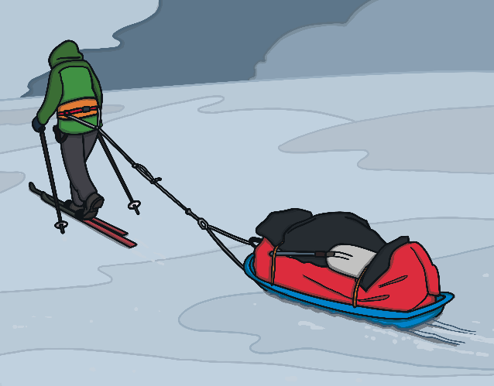
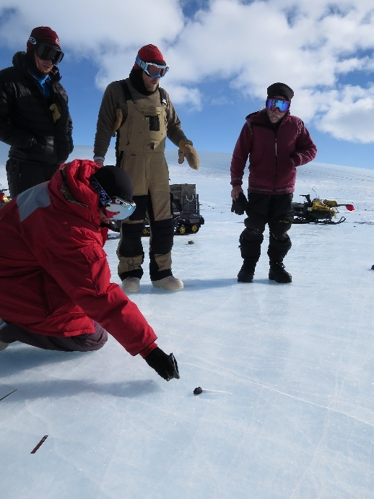
Modern Day Antarctic Exploration
People still travel to Antarctica today, over 100 years after Robert Scott and his team first made it to the South Pole. These explorers go to Antarctica for different reasons.
Other explorers aim to complete different challenges, such as Felicity Ashton who (in January 2012) became the first person to ski across Antarctica without the help of kites or machines.
These explorers are completing scientific experiments to find out about the weather, climate and wildlife.
How do you think exploring Antarctica is different today?

